Slide 1
Developing an algorithm for Process Discovery from Object Centric Event Log
Presented by - Pathak Aum(MMl2023006)
Guided by - Dr.Ranjana Vyas

Slide 2
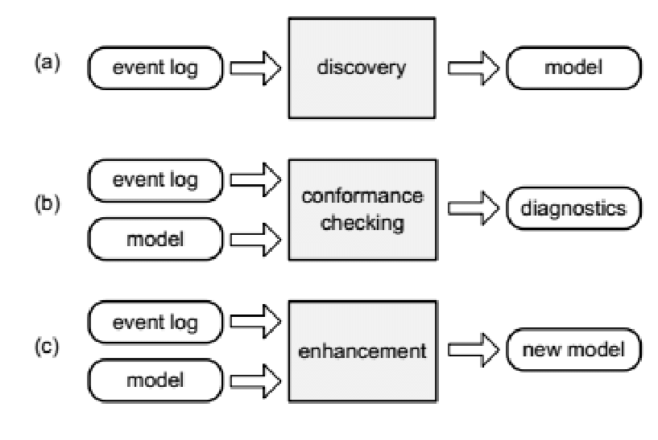
Process Mining
Process Mining is a set of technologies and methodologies used to analyze event logs to discover monitor and improve real processes by extracting knowledge from event log stored in organizational database.Figure[3]

Slide 3
Object Centric Process Mining(OCPM)
Object Centric Process Mining is a approach with a broader field of process mining that focuses on analyses and modelling of process from the perspective of objects or entities involved in the process
In OCPM,Object represents entities such as orders,products,customer,documents or other tangible or intangible items that undergoes transformation or interactions within a process.The analysis revolves around how this object flows through the process,how they are created,how manipulated and eventually transformed or consumed.

Slide 4
Process Discovery Algorithm-Alpha Mining
Define all possible event.Each activity in event log corresponds to transition ɑ(L).
T_{L}={t ∈ T / ∃_{σ ∈L}t ∈ σ }
Consider set of all start activities, and all end activities from traces of given event log
T₁={t ∈ T / ∃_{σ ∈L}t ∈ first(σ) }
T₀={t ∈ T / ∃_{σ ∈L}t ∈ last(σ) }

Slide 5
Calculate possible Sets A and Set (All events within A and within B should be Independent of each other) where all event in A be causally related to events in B.
X_{L}={ (A,B) / A ⊆ T_{L} ∧ A ≠ Φ ∧ B ⊆ T_{L} ∧ B ≠ Φ ∧
∀_{a ∈ A}∀_{b ∈ B}a →_{L}b ∧ ∀_{a1,a2 ∈ A} a1 # _{L}a2 ∧∀_{b1,b2 ∈ B} b1 # _{L}b2 }
Drop non maximum sets
Y_{L}={ (A,B) ∈ X_{L} / ∀_{(A’,B’) ∈ XL} A ⊆ A’ ∧ B ⊆ B’ → (A,B)=(A’,B’) }
Create Places for all derived set and add start & end state
P_{L}={ p_{(A,B)} / (A,B) ∈Y_{L} } ∪ { i_{L ,} o_{L}}

Slide 6
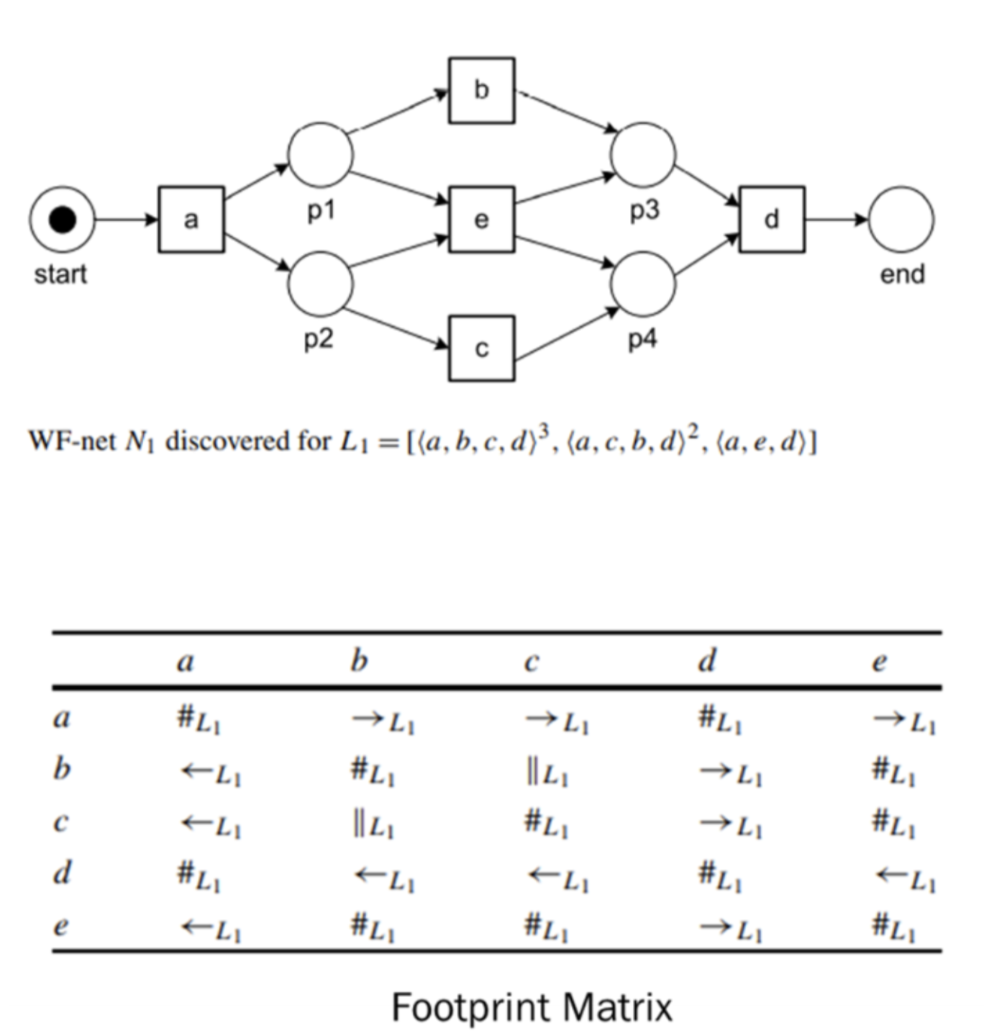
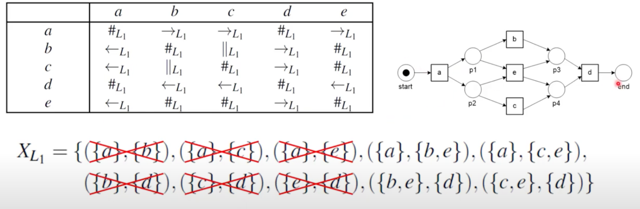
Draw the connections and return petri nets formed.
F_{L}={ (a, p_{(A,B)}) / (A,B) ∈ Y_{L} ∧ a ∈ A } ∪
{ (p_{(A,B)},B) / (A,B) ∈ Y_{L} ∧ b ∈ B}
∪ {(i_{L} , t) / t ∈ T₁} ∪ {( t , o_{L} ) / t ∈ T₀} and
ɑ(L) = (P_{L}, T_{L,} F_{L}).

Slide 7
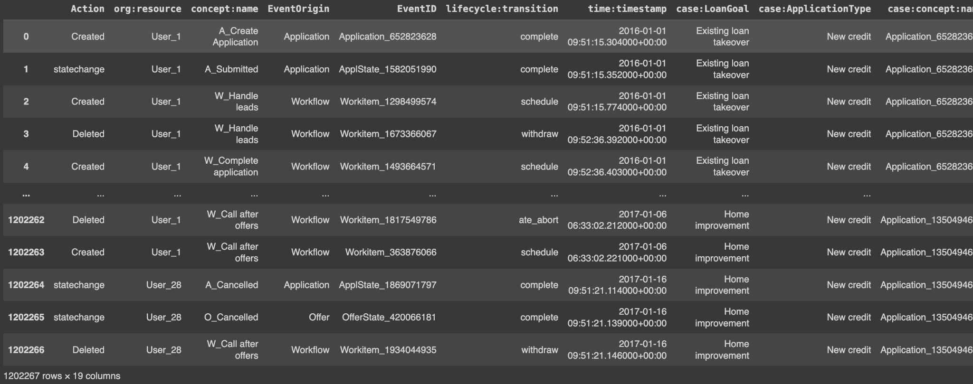
Event Log-BPIC-17
This event log pertains to a loan application process of a Dutch financial institute.
The data contains all applications filed through an online system in 2016 and their subsequent events until February 1st 2017.

Slide 8
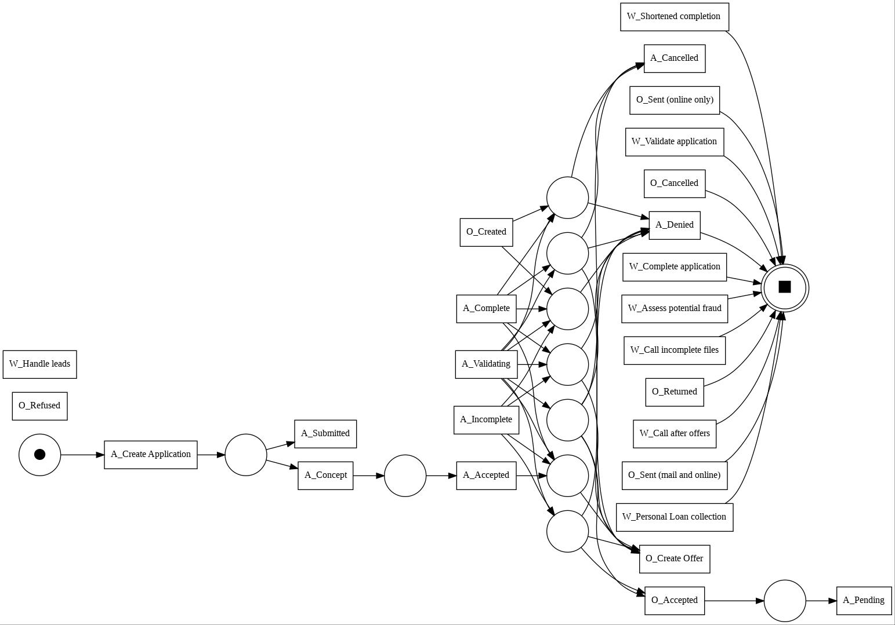
Discovery of Petri Nets using Alpha Mining using Event Log

Slide 9
Generation of Petri Nets on OCEL
Identify Object types
Discover Petri Nets with each object types
Merge the accepting Petri Nets into single Petri nets
Assign Object types to places in merged Petri Nets
Identify the variable arcs.The goal is to identify arcs where multiple tokens needs to be consumed or produced.
Return Object centric Petri Nets generated in last three steps

Slide 10
Object Centric Event Log-BPIC-17
This dataset contains the result of transforming the BPI Challenge 2017 event log in Object-Centric Event Log (OCEL) format.
Events-1202267
Object types
Application-For loan application
Workflow-Object for internal working of bank
Offer-Object for providing offer
Case_R-Object relating all the different objects

Slide 11
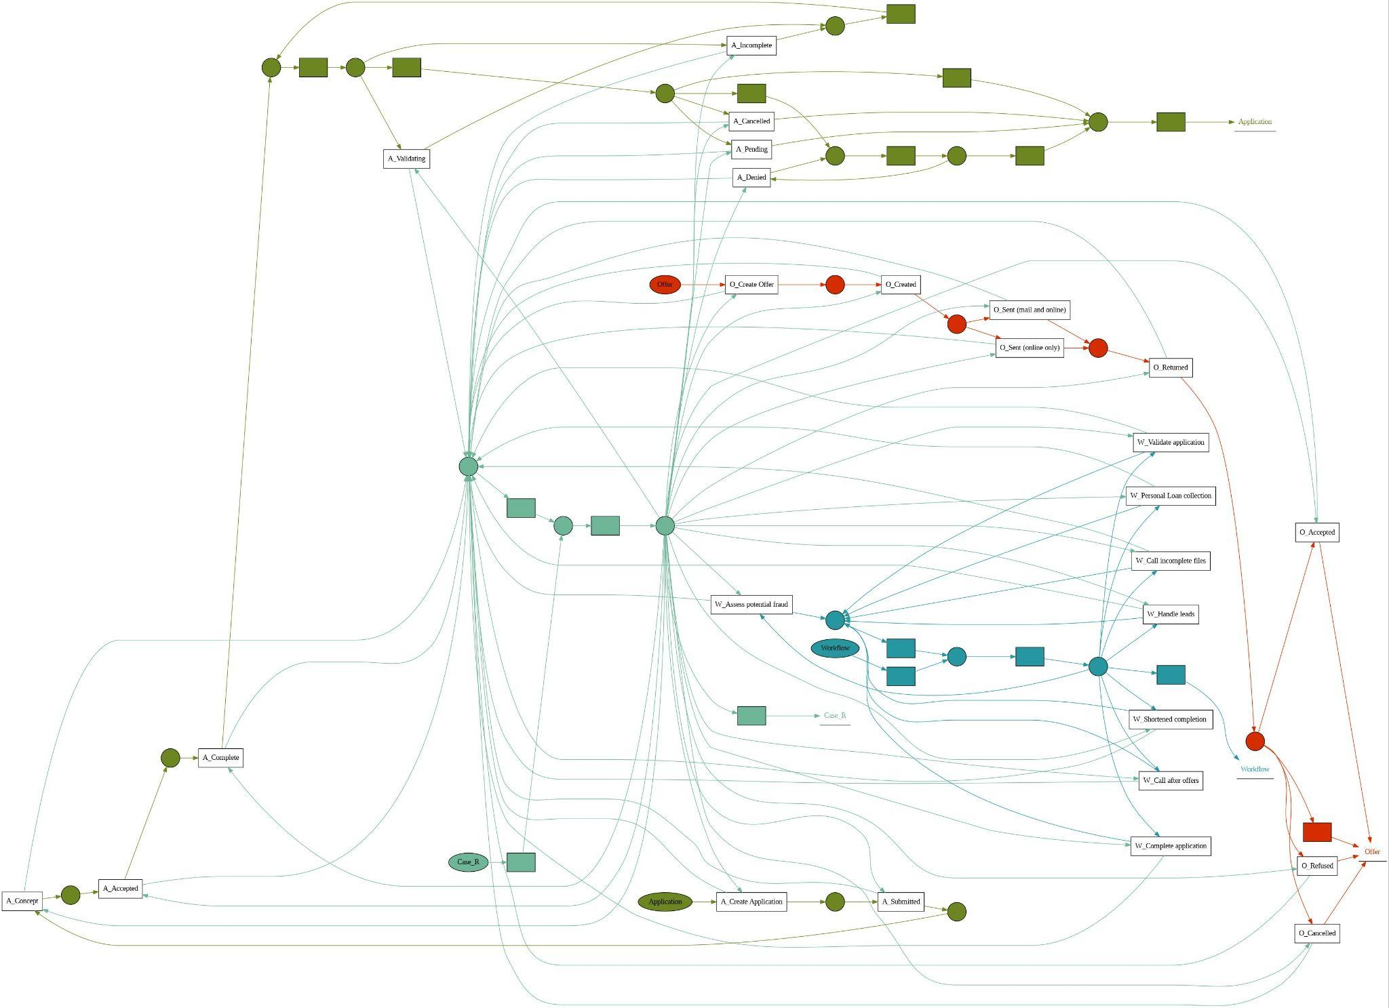
Discovery of Petri Nets using Alpha Mining using OCEL

Slide 12
Problem Statement
Object-centric event logs offer a rich source of information regarding the activities performed by diverse entities within a system.
However, the absence of a tailored algorithm for discovering Petri nets from such logs presents a substantial hurdle.
As existing implementations in libraries like pm4py can generate Petri nets from Object-Centric Event Logs (OCEL) is a generic approach and isn’t defining a specific discovery algorithm, and produces a very complex models.

Slide 13
Discovering Object Centric Event Log[1]
Author-Van der Aalst and berti
Publishing Year-2020
The paper introduces a novel approach to discovering Petri nets from event data, focusing on multiple intertwined case notions. The study discusses the challenges of analyzing event data with complex relationships between cases and highlights the differences between Object-Centric Petri Nets and traditional Petri nets. The research emphasizes the potential applications of Object-Centric Petri Nets in process and data science research, showcasing its relevance and impact in the field.

Slide 14
OCPM-Unraveling Fabrics of Real Processes[2]
Author-van der Aalst
Publishing Year-2023
It discusses the limitations of traditional two-dimensional event logs and models in capturing the complexities of real-world processes. It emphasizes the need for three-dimensional event logs and models to represent all object types accurately. The review also highlights the growing significance of process mining tools from over 40 vendors, showcasing their capabilities in process discovery, conformance checking, performance analysis, and process prediction. Additionally, it mentions the practical relevance of understanding events involving multiple objects in process mining applications.

Slide 15
Process Mining:Overview and Outlook of Petri Nets Discovery Algorithm[3]
Author-Lijie Wen
Publishing Year-2009
In the field of process mining, research on process discovery focuses on constructing process models from event logs.Author emphasize the importance of incorporating contextual information and semantic meaning from event logs to enhance process models. Various studies explore algorithms like Heuristics Miner and Petri net discovery methods, highlighting the significance of formal methods and advanced algorithms in improving process understanding and optimization within organizations. Overall, it underscores the ongoing efforts to leverage innovative techniques for enhancing business processes and decision-making through process mining.

Slide 16
Discovering Petri Nets from Event Log[4]
Author-Aalst,Wil & Dongen, Boudewijn.
Publishing Year-2009
Process mining involves extracting insights from event data to understand business processes. Process discovery, a key aspect of process mining, focuses on constructing process models from event logs. Techniques like Petri nets are used for modeling complex processes, with algorithms like the α-algorithm aiding in pattern identification. Researchers have contributed to improving process discovery algorithms. The field continues to evolve, bridging theory with practical applications to enhance process analysis and decision-making.

Slide 17
Proposed Methodology
Identification of activities in Log and Objects types
Identify the set of start activity and end activity
Calculate and identify the ordered pairs with help of Contingency table
Define the connection between Objects

Slide 18
Reference
[1]van der Aalst, W. M., & Berti, A. (2020). Discovering object-centric Petri nets. Fundamenta informaticae, 175(1-4), 1-40.
[2]van der Aalst, W.M.P. Object-Centric Process Mining: Unraveling the Fabric of Real Processes. Mathematics 2023, 11, 2691. https://doi.org/10.3390/math11122691
[3] Wen, Lijie. (2009). Process Mining: Overview and Outlook of Petri Net Discovery Algorithms.
[4]Aalst, Wil & Dongen, Boudewijn. (2013). Discovering Petri Nets from Event Logs. 10.1007/978-3-642-38143-0_10.

